Slide 1






Smart Air Humidifier
Group 20
Alperen Gökalp Durmuş 070230337
Baran Göktürk 070220383
Berin Arıcı 070200237
Mehmet Melih Eroğlu 070220373
Naci Hakan İlgün 070190213
Nihat Devrim Şen 070210741
Onur Nazik 070200295
Özge Şenol 070200313

Slide 2


COMPANY INTRO
Sustainability
Energy Efficiency
Innovative Dehumidifiers
Healthier Indoor Environments
High-Quality Solutions
AI & UV-LED
Costumer Satisfaction

Slide 3


VISION & MISSION
Leading Global Provider
Innovative
VISION
Improve Lives
MISSION
Reliable Products
Comfortable Environments
High Air Conditions

Slide 4
CORE VALUES
Shaping a Sustainable Future
Advancing Humidification Technology
Supporting Local Industry
& Workforce Development
SUSTAINABLE
Customer-First Philosophy

Slide 5
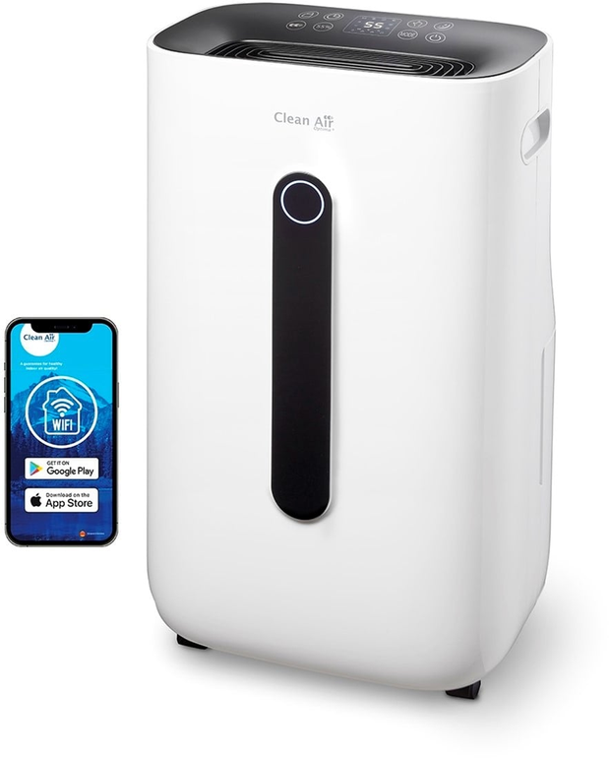
Introduction-Our Product Dehumidifier with UV-Led Technology
UV Air Purification:
Built-in UV LEDs eliminate airborne bacteria and allergens.
Smart Humidity Control:
Automatically maintains desired humidity levels based on environmental conditions.
Energy Efficiency:
Optimized operation for minimal energy consumption.
User-Friendly Interface:
Intuitive control panel with easy-to-use settings.

Slide 6
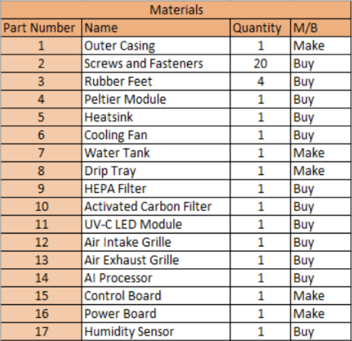
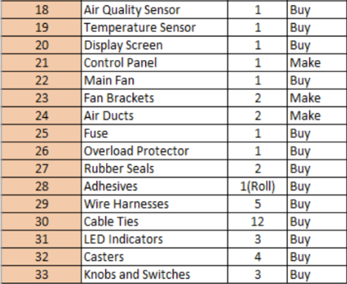

Make-Buy Decisions
Out of 33 parts required determined for the dehumidifier, 8 parts will be produced in the factory.

Slide 7

Production Decisions
Assembly focused
A hybrid production system
Initial batch of 5000 units (Pull production)

Slide 8


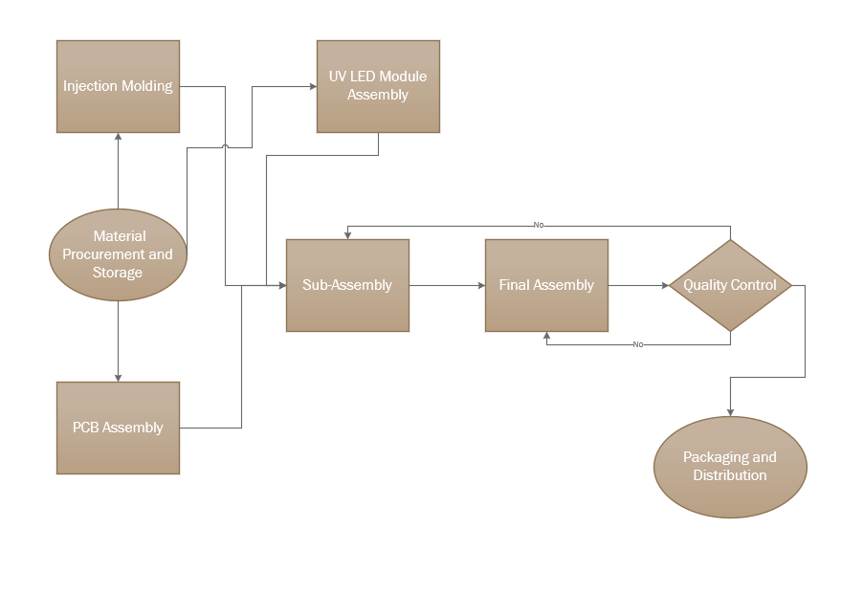

Workflow Diagram

Slide 9
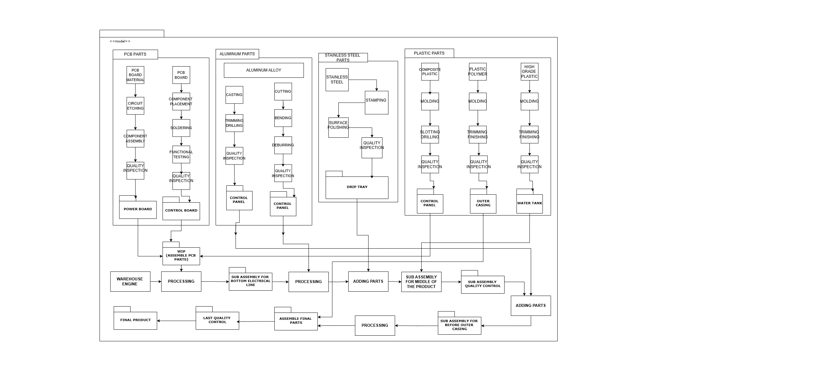
Fabrication of Individual Parts

Slide 10

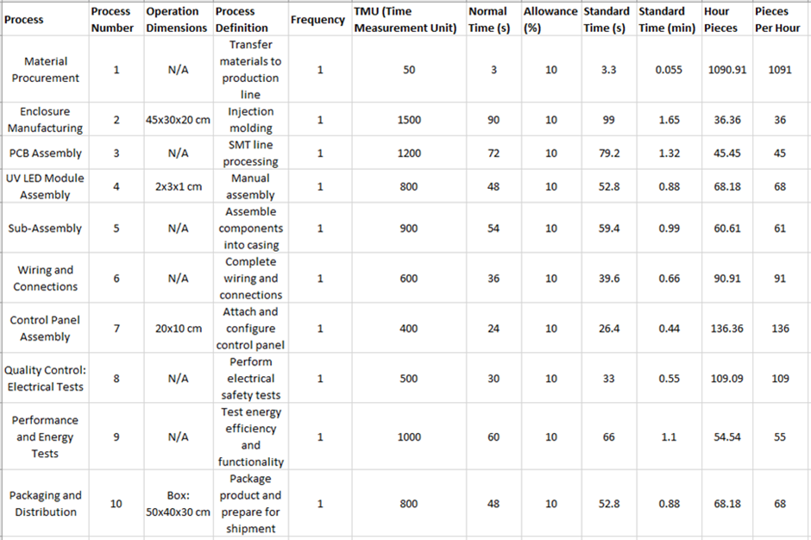

Time Study
Total Estimated Time for One Unit:
6960 TMU (~116 minutes)

Slide 11
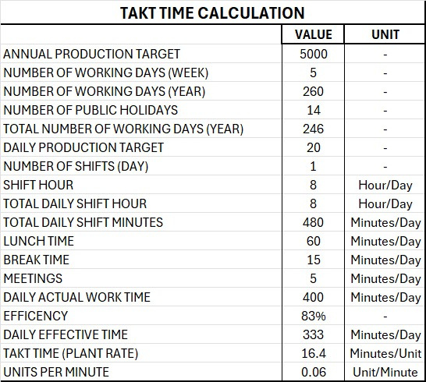
Takt Time

Slide 12
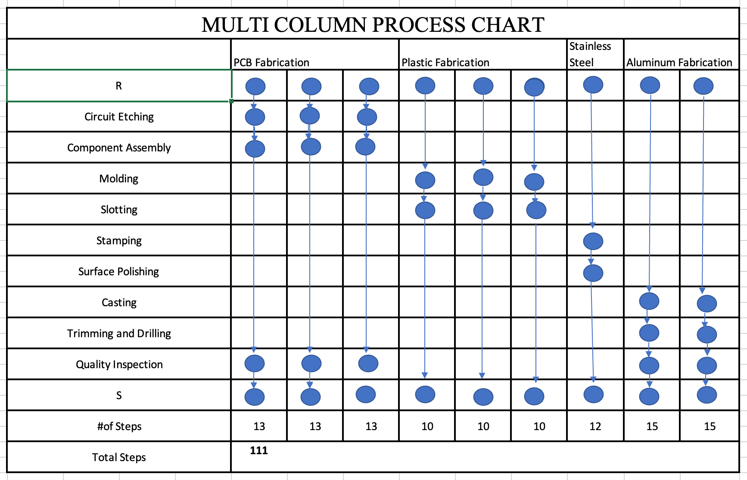
Multi Column Process Chart

Slide 13

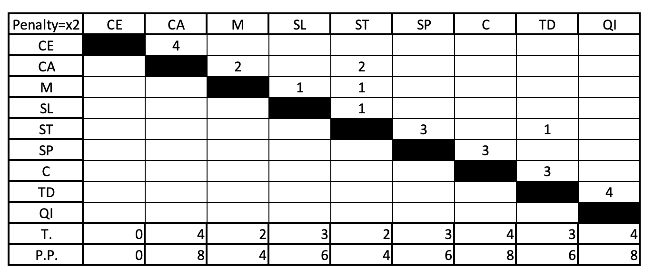
From - To Chart

Slide 14
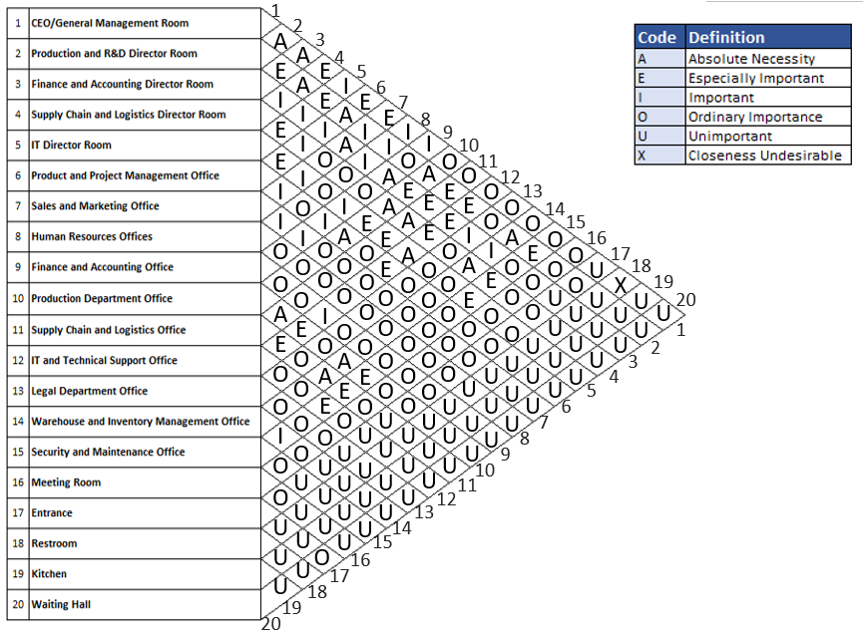
Activity Relationship Diagram

Slide 15
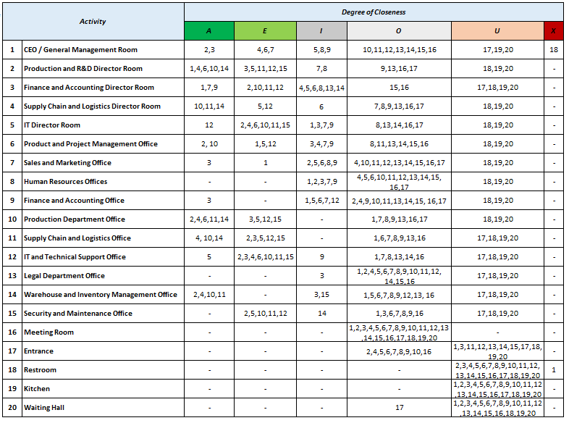


Activity Relationship
Table

Slide 16

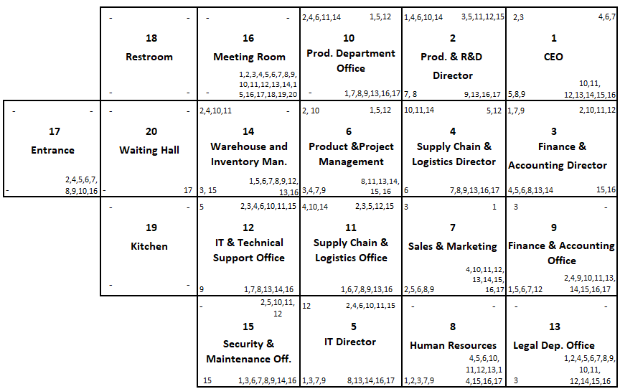
Dimensionless Block Diagram

Slide 17
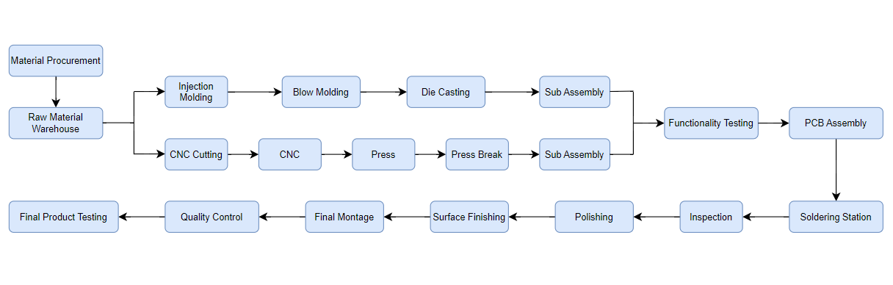
Material Flow Diagram

Slide 18
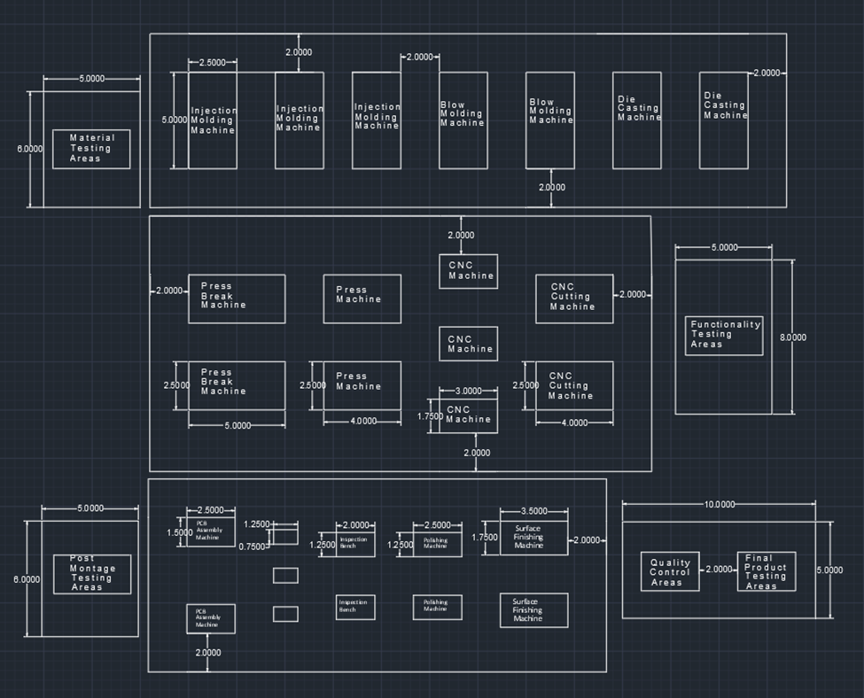
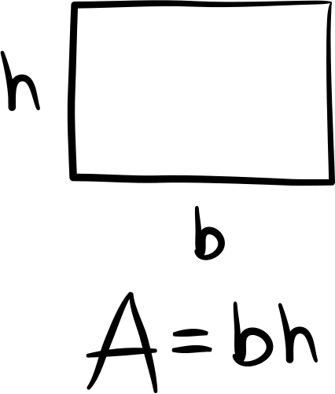
Total Production Area

Slide 19


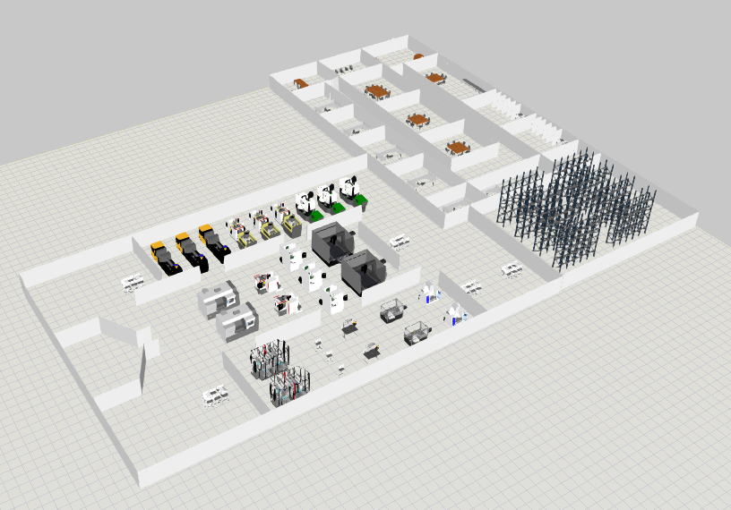
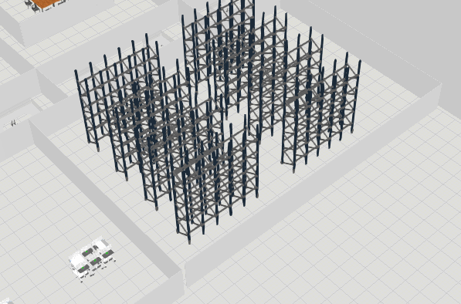
Facility Design and Visual Components
Full Facility
Storage

Slide 20
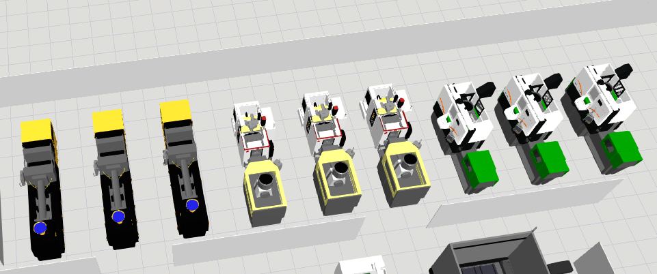

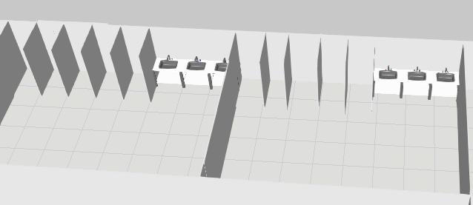

Blow Molding
Die Casting
Injection Molding
Bathrooms

Slide 21
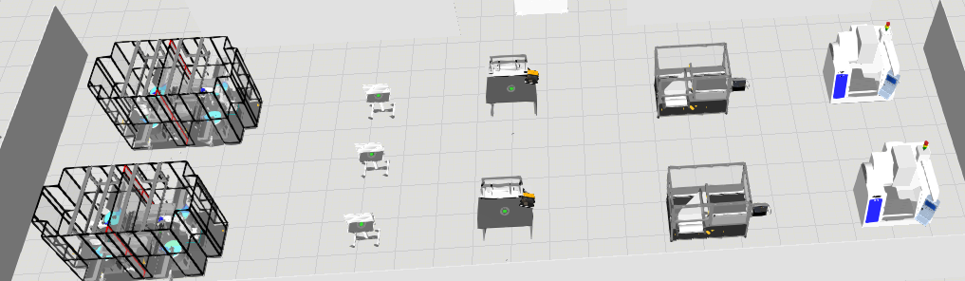

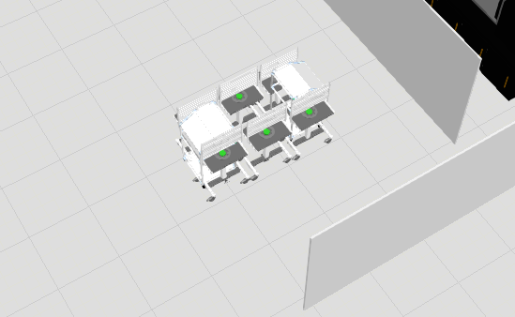

Soldering
Stations
Polishing
Machine
PCB
Assembly
Inspection Bench
Surface
Finishing
Machine
Material Testing Area

Slide 22

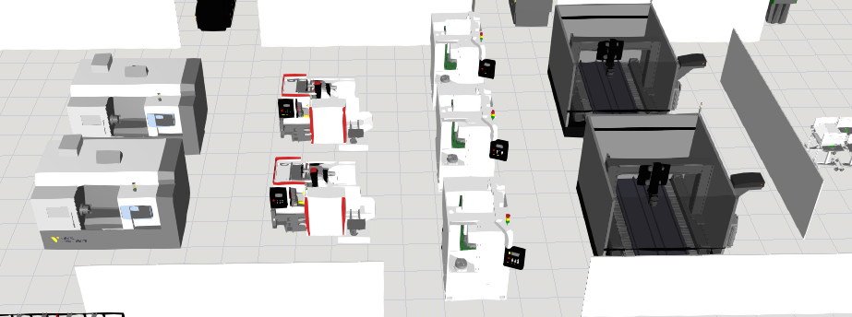

Press Break Machine
CnC Machine
Press Machine
CnC Cutting Machine

Slide 23

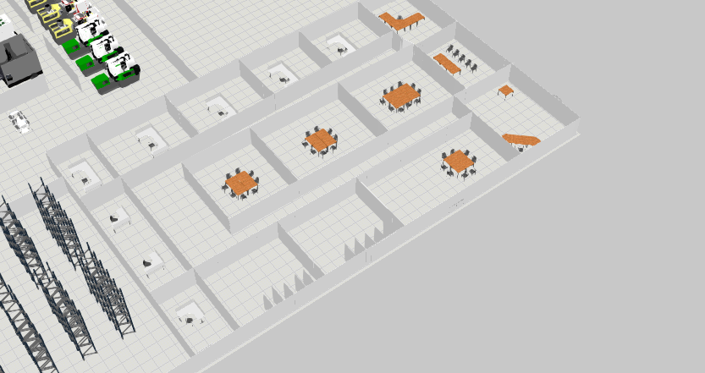
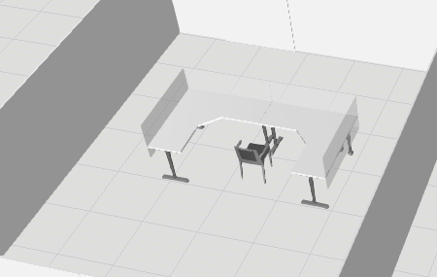
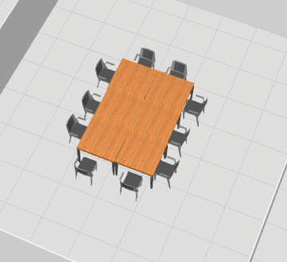
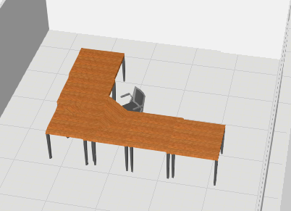
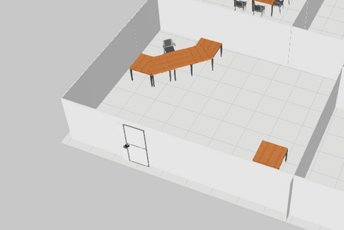


Office
Director Rooms
Conferance Room
CEO Office
Enterance

Slide 24
Thank
You
Presented by Group 20

